Slide 1
ADVANCING PATIENT SAFETY IN PEDIATRIC CARE
—
BRIDGING VULNERABILITY WITH VIGILANCE

Slide 2
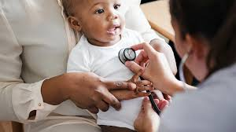
BACKGROUND
Pediatric patients represent a uniquely vulnerable population within healthcare systems, requiring specialized attention to safety due to their developmental, physiological, and communication differences.
Ensuring their safety is not merely a clinical obligation—it is a moral imperative.

Slide 3
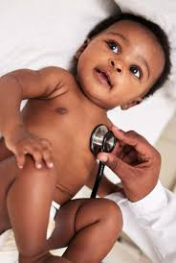
Objective
This presentation explores the evolving landscape of patient safety in pediatric care, highlighting key risk factors, systemic challenges, and innovative strategies aimed at minimizing harm and enhancing outcomes.

Slide 4
METHODS AND INSIGHTS
Drawing from recent case studies, safety audits, and interdisciplinary research, the session will examine:
Common sources of pediatric safety incidents, including medication errors, miscommunication, and procedural oversights.
The role of technology—such as smart dosing systems and electronic health records—in reducing preventable harm.
Family-centered care models that empower caregivers as active participants in
safety protocols.
Training innovations, including simulation-based learning and safety culture workshops, that foster resilience and responsiveness among pediatric teams.

Slide 5
CONCLUSION
To safeguard children effectively, healthcare systems must adopt a proactive, data-informed, and compassionate approach to patient safety.
This presentation calls for a cultural shift—where safety is embedded not just in protocols but in the ethos of pediatric care.
Attendees will leave with actionable strategies to strengthen safety frameworks and advocate for systemic improvements that honor the trust placed in pediatric providers.

